Slide 1
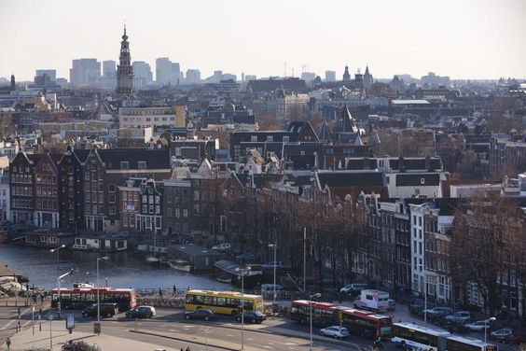
Pollution in Amsterdam
A focus on Einsteinweg and Vondelpark
Team: Sreelatha Chunduri & Eva Donaque
Date: Feb 29, 2020

Slide 2
Facts
Elevated concentrations of air pollutants, such nitrogen dioxide (NO2) and particulate matter (PM10 and PM2.5) have adverse effects on human health.
To improve the air quality various policy measures have been taken in Europe since the 1970s.
Soure: https://www.rivm.nl/en/node/148421

Slide 3
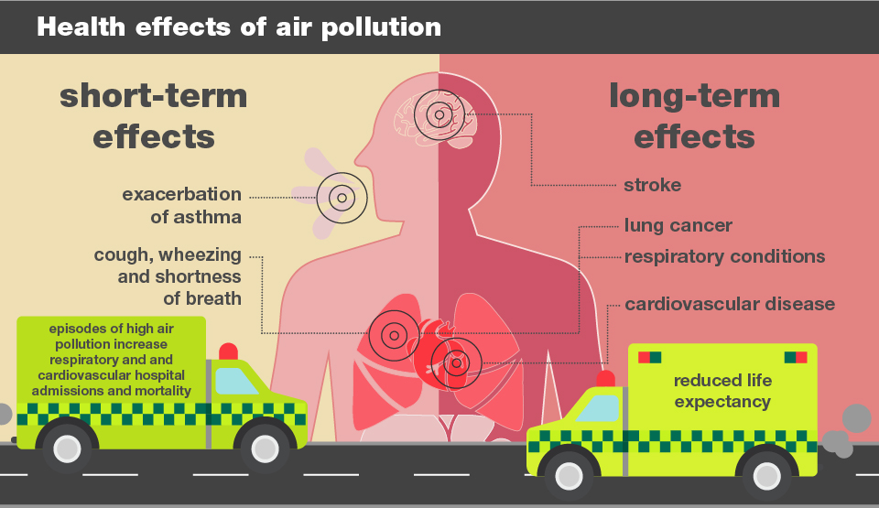

Slide 4
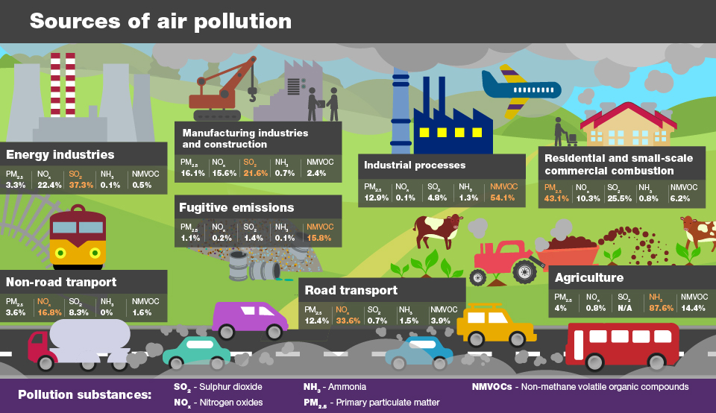

Slide 5



Randstad residents are three times more likely to get cardiovascular diseases or serious lung diseases from pollution than people living in Drenthe, Groningen or the islands.
Amsterdam residents suffer same health detriments by breathing the polluted air from the city than from passively smoking 6.4 cigarettes
“Amsterdam residents live a year less on average due to dirty air”. says transport chief Sharon Dijksma (2019)
A 6-year increase in life expectance is attributed to the avoided air pollution in the Netherlands!

Slide 6

Policies that affect Amsterdam
“Amsterdam residents live a year less on average due to dirty air”
- Transport chief Sharon Dijksma (2019)
Plans:
November 2020: Diesel-powered cars predating 2005 are not allowed in the A10 ring area.
January 2021: Metro will be open 24h during the weekends/public holidays and public transport will be free for kids under 12 years during the weekends/public holidays.
January 2022: Buses and coaches allowed in if they have
January 2025: Amsterdam will need 16,000 to 25,000 car charging stations. Currently in 2020 there are approx. 3,000 charging stations.
January 2030: Ban on all gas-and-diesel powered cars

Slide 7


Research Questions & Hypothesis
Q1. Is there a decrease in pollution from 2012 through 2019 because of new policies?
Q2. Is one neighbourhood's pollution level better than the other neighbourhood? If yes, what are the reasons?
Hypothesis
Traffic (all types of vehicles including bicycles) emissions are directly proportional to the air quality; and increase in hybrid cars and associated policies have reduced the pollution.
The increase in green spaces helps in the improvement in the air quality of the neighborhoods.

Slide 8
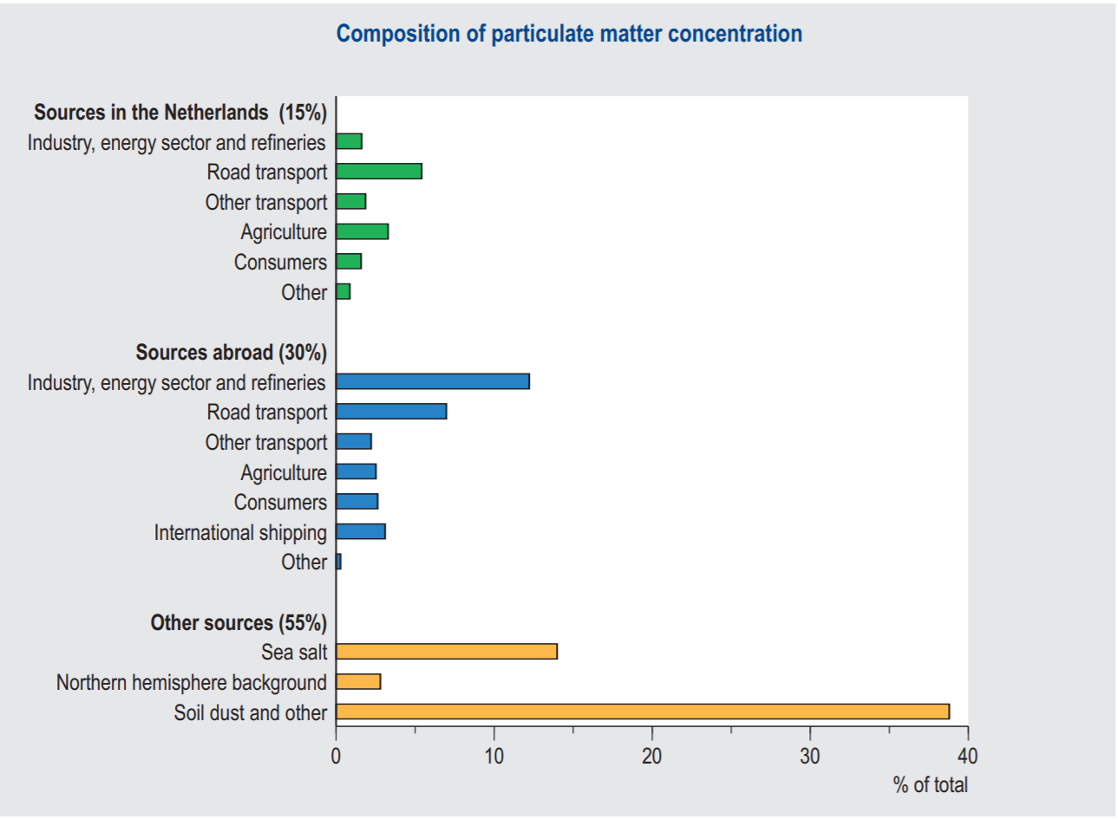
Emissions in Amsterdam

Slide 9
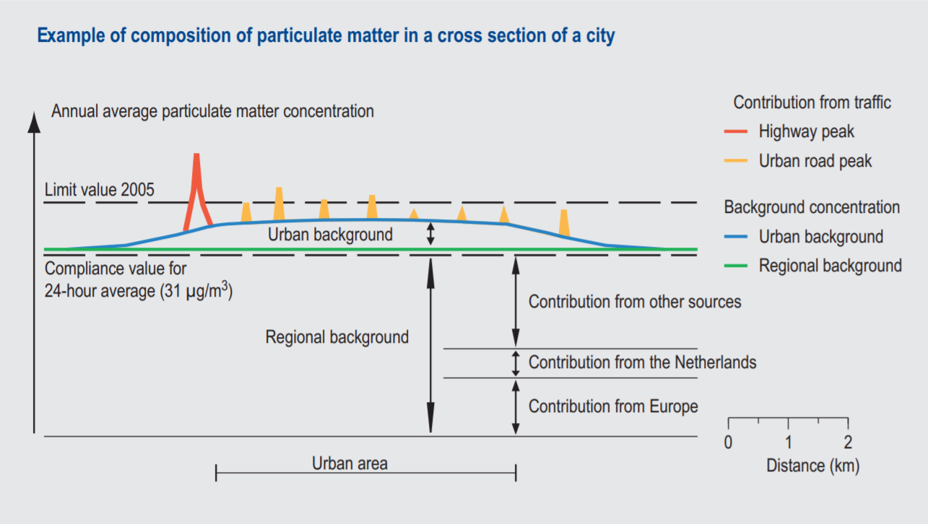

Slide 10
Approach & Workflow
For our current study we chose to study the trend of 3 pollutants that includes NO2, PM2.5 and PM10 in Amsterdam.
Einsteinweg - A10 West
Van Diemenstraat
Vondelpark
Stadhouderskade

Slide 11
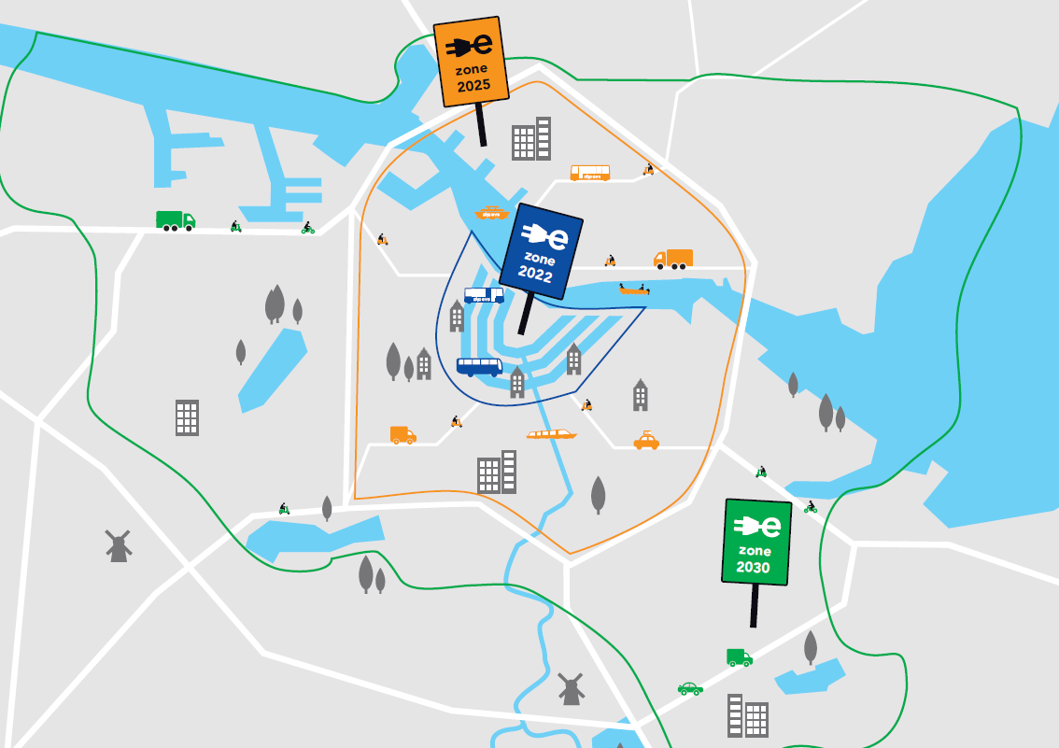
Comparison between West (Vondelpark) and Nieuw West (Einsteinweg)

Slide 12
Analysis Types
Qualitative Analysis
Quantitative Analysis

Slide 13
Qualitative Analysis

Slide 14
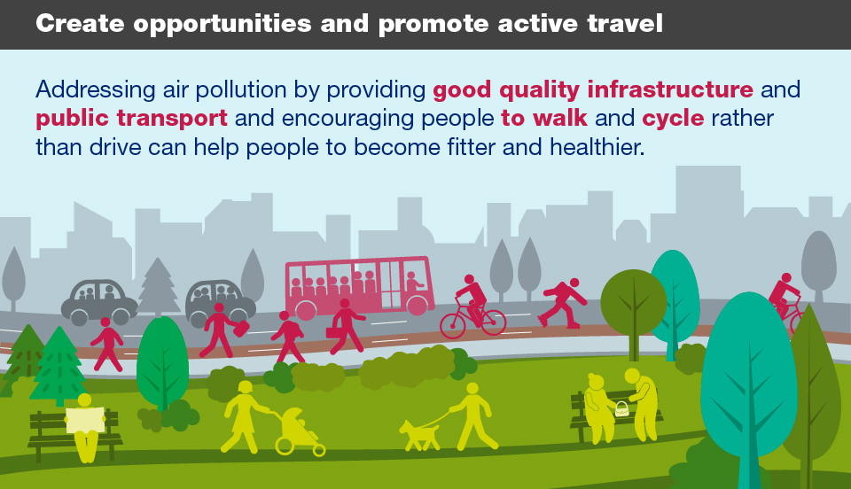

Slide 15
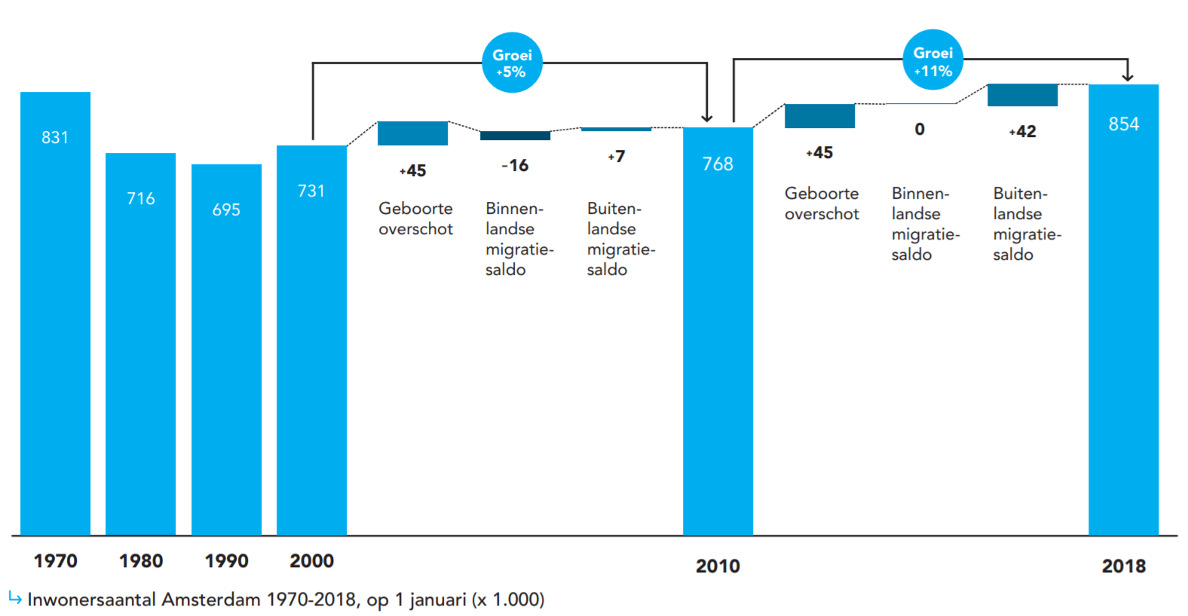
Population in Amsterdam
11% growth in population from 2010 to 2018

Slide 16
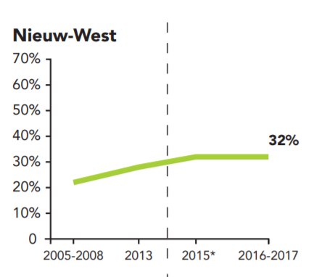
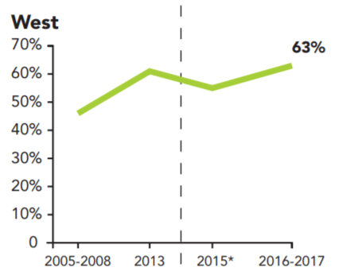

Bicycle Usage West and Nieuw-west
People in the West use far more bikes than people in Nieuw West
 | Cycle Path in Kms
Vondelpark | 67
Einsteinweg (Nieuw-West) | 190

Slide 17
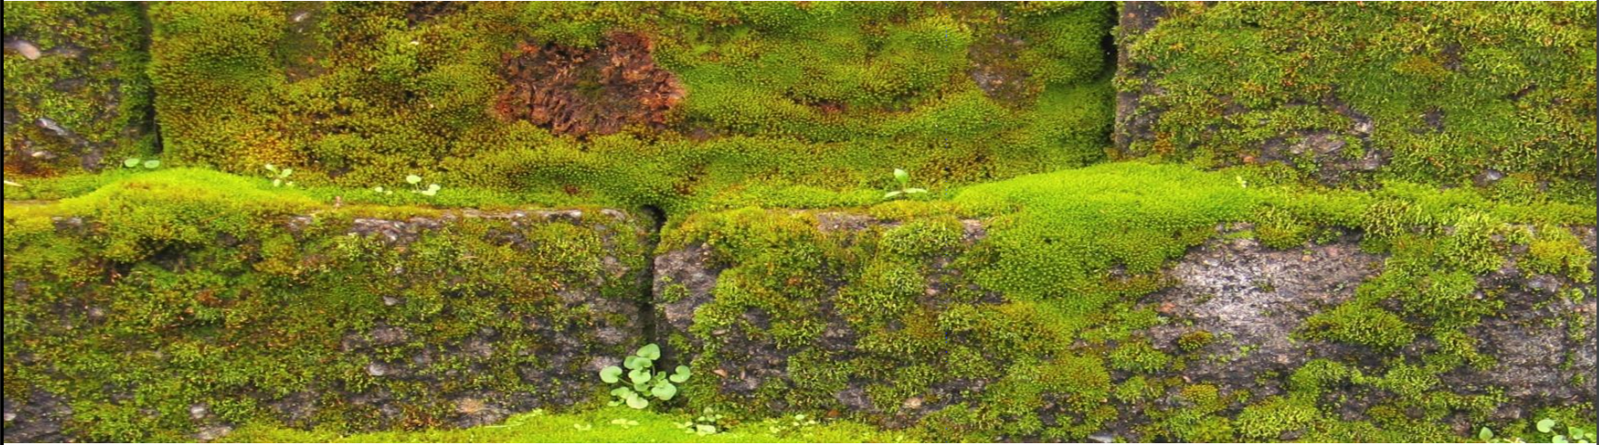
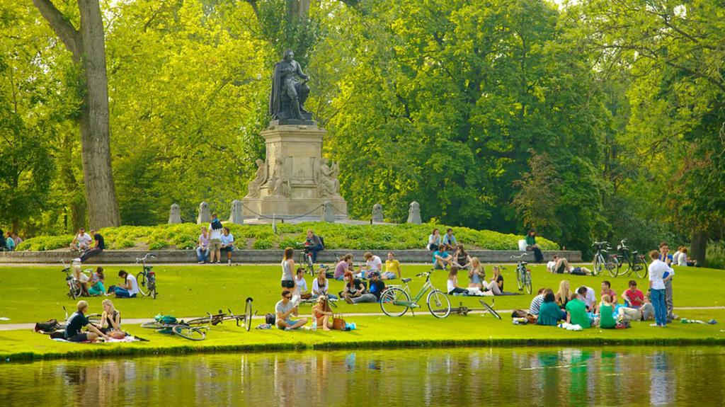
Greenery in West and Nieuw West
Air pollution is a global threat to public health. Particulate matter (PM 2.5) plays a big roll.
Literature study shows that a vegetation reduces the particulate matter concentration in the air as the different plant species collect the fine dust on their leaves.
Vegetation Barrier along Einsteinweg is reducing PM 2.5
Vondelpark is improving the air-quality in the area

Slide 18
Quantitative Analysis

Slide 19
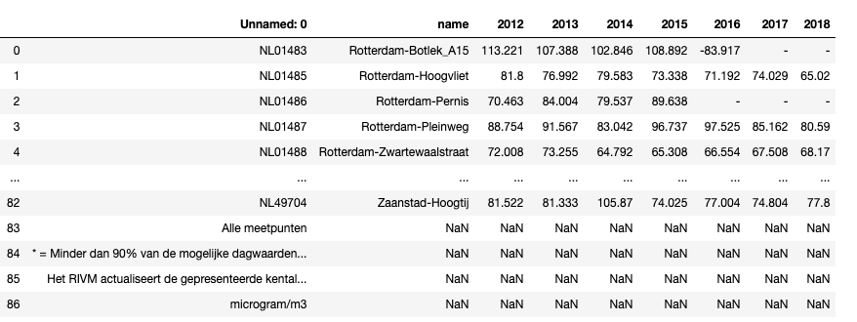
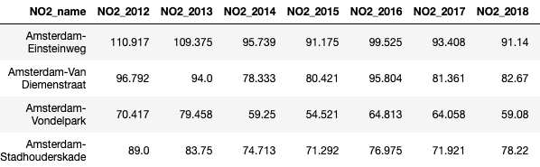
NO2
Pollutant Data for all the areas in NL
Pollutant Data for neighborhoods in Amsterdam

Slide 20
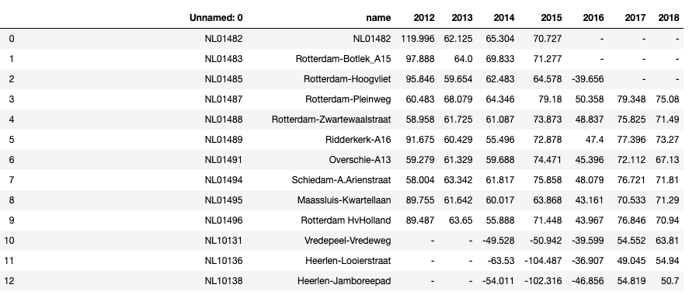
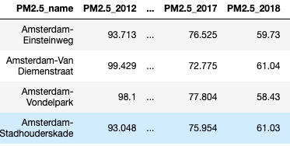
PM2.5
Pollutant Data for all the areas in NL
Pollutant Data for neighborhoods in Amsterdam

Slide 21
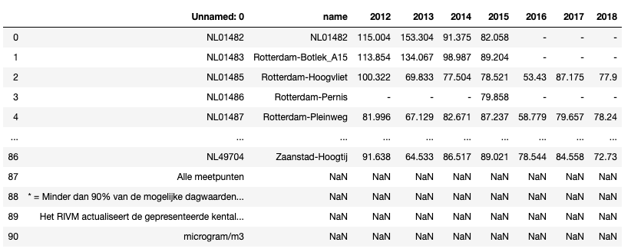
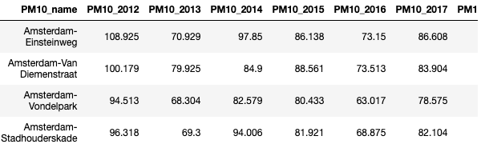
PM10
Pollutant Data for all the areas in NL
Pollutant Data for neighborhoods in Amsterdam

Slide 22
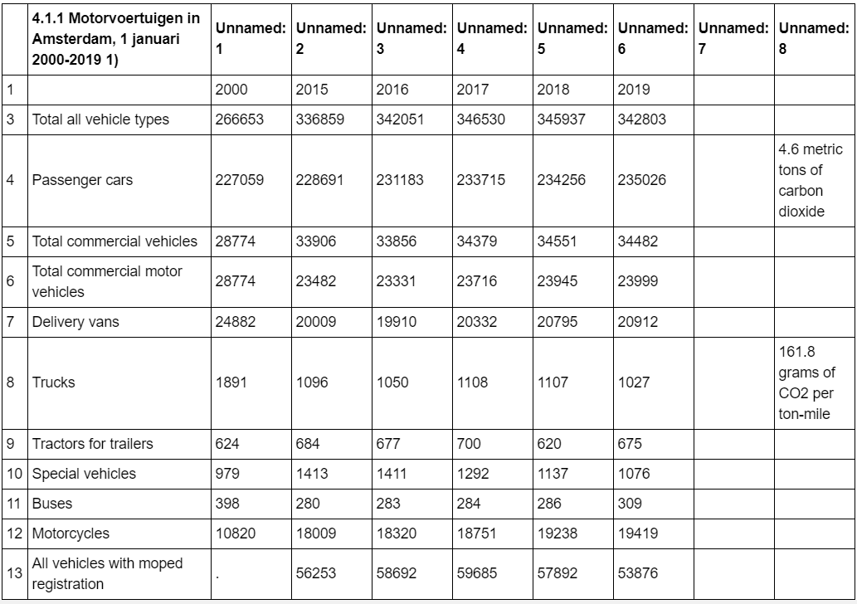
Vehicles Data
Total Number of Vehicles in Amsterdam
Number of Vehicles have increased from 2000 through 2019

Slide 23
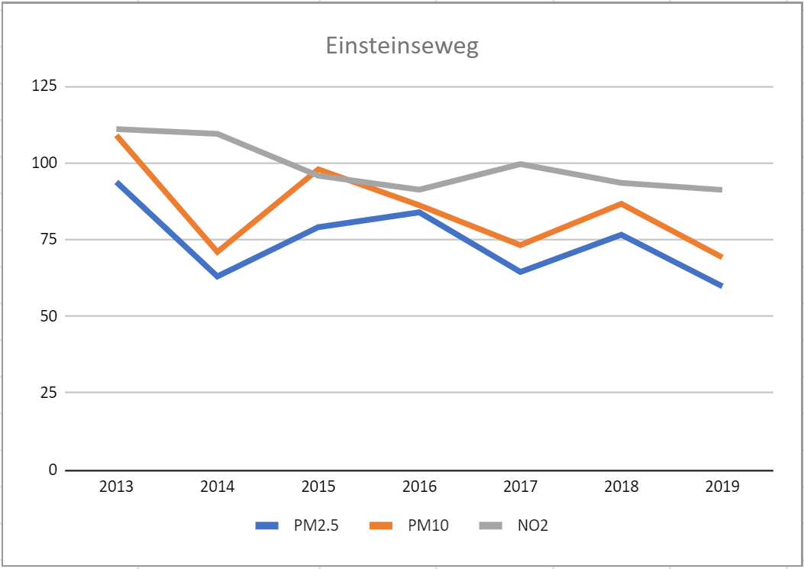
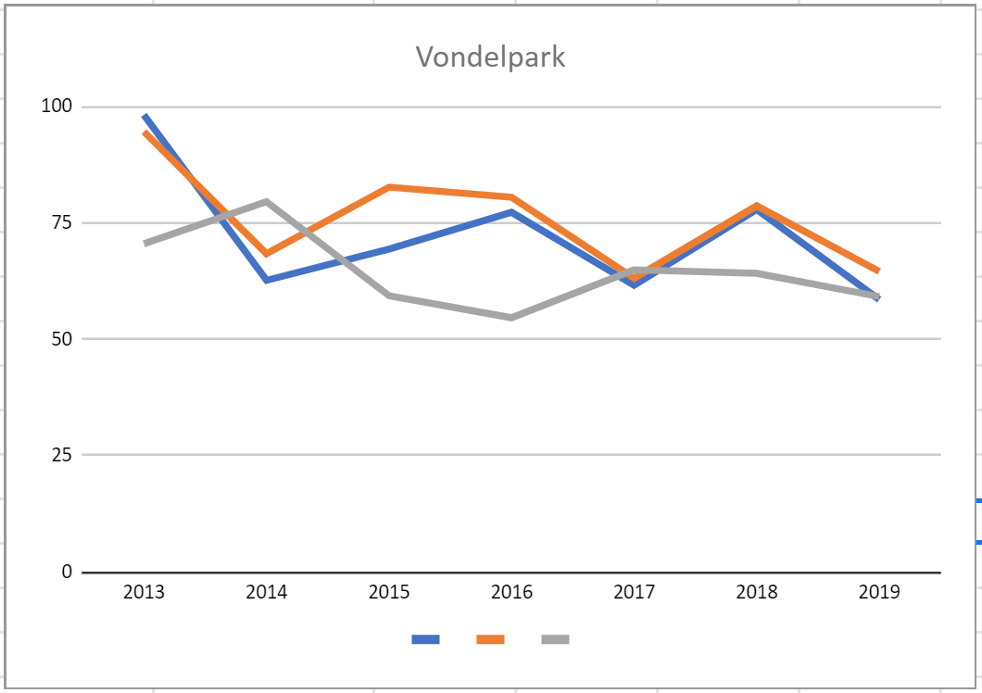
Analysis

Slide 24

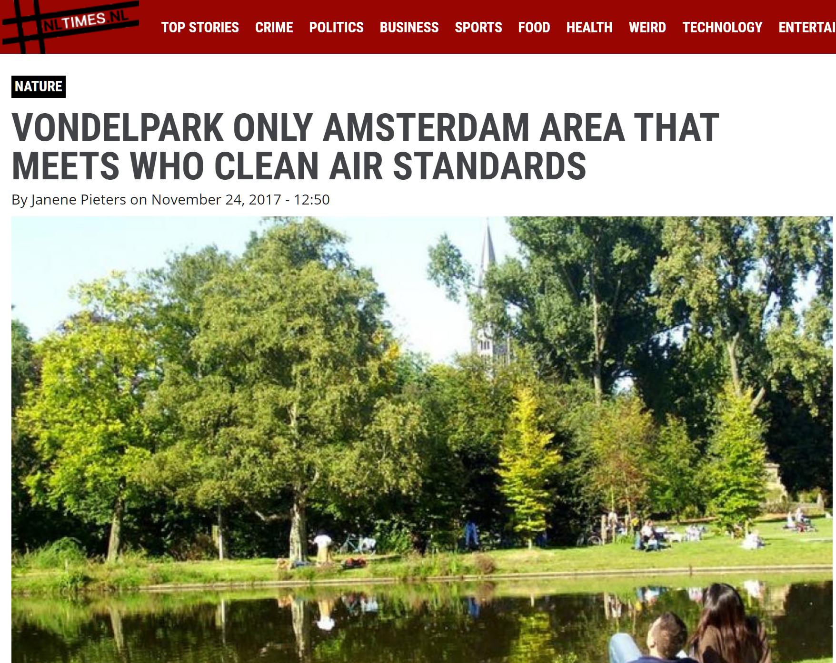
Research Questions, Hypothesis & Findings
Findings
Traffic (all types of vehicles including bicycles) emissions are directly proportional to the air quality; and increase in hybrid cars and associated policies have reduced the pollution. – Proved to be False
The increase in green spaces helps in the improvement in the air quality of the neighborhoods. - . – Proved to be True

Slide 25
Key Learnings
Hard to find data and hard to find correlation between completely different data types
Hard to find relationship between qualitative and quantitative data
Analyzing data from the data frames is not intuitive

